Slide 1
Taken From Modern Systems Analysis and Design Eighth Edition Joseph S. Valacich Joey F. George
DFD

Slide 2
Learning Objectives
Understand the logical modeling of processes by studying examples of data flow diagrams (DFDs).
Draw data flow diagrams following specific rules and guidelines that lead to accurate and well-structured process models.
Decompose data flow diagrams into lower-level diagrams.

Slide 3
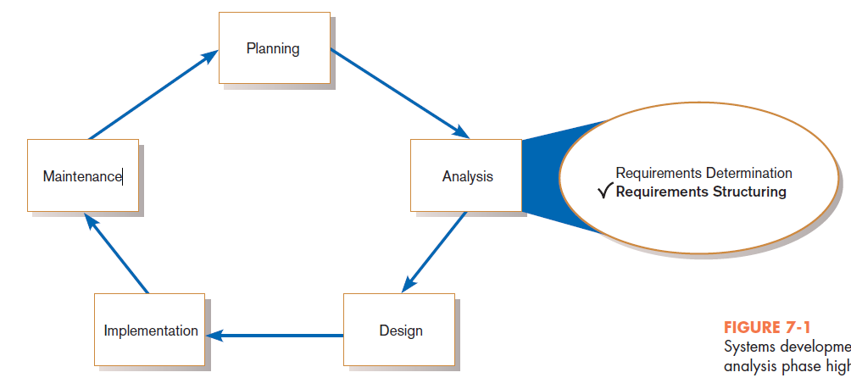
Process Modeling for Structured Analysis
FIGURE 7-1
Systems development life cycle with the analysis phase highlighted

Slide 4
Process Modeling (Cont.)
Graphically represent the processes that capture, manipulate, store, and distribute data between a system and its environment and among system components.
Utilize information gathered during requirements determination.
Model processes and data structures.
Notes:
DFDs have symbols for processes, data stores, and external environmental agents, as we’ll see soon.

Slide 5
Deliverables and Outcomes
Context data flow diagram (DFD)
Scope of system
DFDs of current physical system
Adequate detail only
DFDs of current logical system
Enables analysts to understand current system

Slide 6
Deliverables and Outcomes (Cont.)
DFDs of new logical system
Technology independent
Show data flows, structure, and functional requirements of new system
Thorough description of each DFD component

Slide 7
Data Flow Diagramming Mechanics
Represent both physical and logical information systems
Only four symbols are used
Useful for depicting purely logical information flows
DFDs that detail physical systems differ from system flowcharts which depict details of physical computing equipment.
Notes:
The primitives of DFD diagramming are very simple.

Slide 8
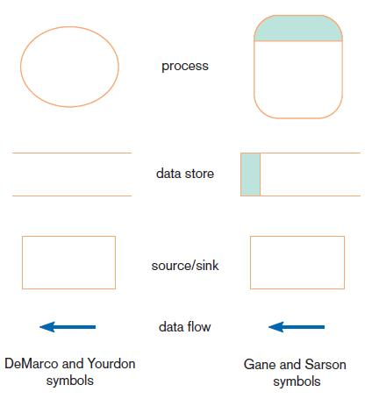
Definitions and Symbols
FIGURE 7-2
Comparison of DeMarco and Yourdon
and Gane and Sarson DFD symbol sets
Notes:
Here are two versions of DFD symbols for processes, data stores, sources and sinks, and data flows.
As in all types of diagrams (E-R diagrams included) data flow diagrams come in different flavors of symbol notation. But whatever symbols you use, the key in DFDs is that you are representing processes, data stores, sources and sinks, and data flows.
E-R means entity-relationship. Those types of diagrams are important for designing databases, and we’ll talk about them starting in chapter 8. In this chapter we focus on data flow diagrams (DFDs), which are more important for analyzing process flows and designing application systems.

Slide 9
Definitions and Symbols (Cont.)
Process: work or actions performed on data (inside the system)
Data store: data at rest (inside the system)
Notes:
The process is some task taking place. We generally think of DFDs are representing computer systems, but it can also represent work flows in an organization. So, processes could represent computer activities or human activities, or a combination of both.
The data store will generally be a file or a database. Unless, of course, this is a manual system. In that case, the data store could be a file cabinet containing paper documents.

Slide 10
Definitions and Symbols (Cont.)
Source/sink: external entity that is the origin or destination of data (outside the system)
Data flow: arrows depicting movement of data
Notes:
The source and sink are entities outside the system, so they are part of the environment. A source sends data which becomes input to the system, and a sink receives outputs from the system.
Processes receive data as input and send data as output. They receive data from other processes or from sources. They send data to other processes or to sinks.

Slide 11
Developing DFDs
Context diagram is an overview of an organizational system that shows:
the system boundaries.
external entities that interact with the system.
major information flows between the entities and the system.
Note: only one process symbol, and no data stores shown
Notes:
DFDs can be drawn at various levels of detail. The “context diagram” is at the highest level. In this case, the one process represents the system as a whole, and the only other entities are sources and sinks.

Slide 12
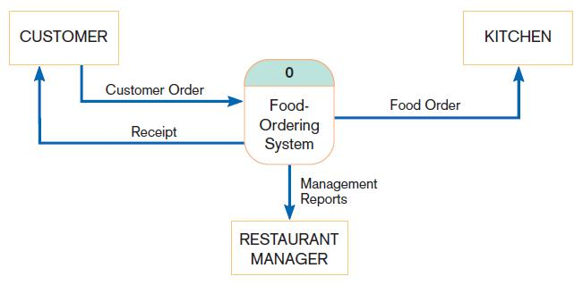
Context Diagram
FIGURE 7-4
Context diagram of Hoosier Burger’s food-ordering system
Notes:
So, this figure shows a birds-eye view of the system and the other entities that it interacts with. A customer sends an order to the system, which then sends a food order to the kitchen, a report to the restaurant manager, and a receipt back to the customer.
In this diagram, and in subsequent diagrams, the processes are computer activities, as we’ll see. The sources and sinks, though, are generally people, or groups of people. That’s not always the case, though. A source or sink could also be an external computer system.

Slide 13
Developing DFDs (Cont.)
Level-0 diagram is a data flow diagram that represents a system’s major processes, data flows, and data stores at a high level of detail.
Processes are labeled 1.0, 2.0, etc. These will be decomposed into more primitive (lower-level) DFDs.
Notes:
After the highest-level context diagram, there are more detailed diagrams of various levels. The next highest level is Level-0, which depicts the main processes of the system as a whole. Each of these processes can in turn be represented in more detail in Level-1 diagrams, which can be refined in Level-2, etc.

Slide 14
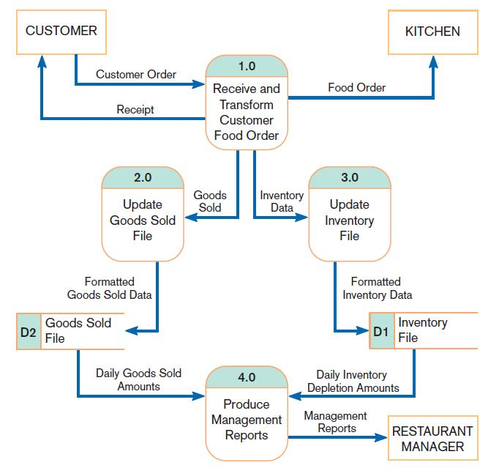
Level-0 Diagram
FIGURE 7-5
Level-0 DFD of Hoosier Burger’s food-ordering system
Notes:
So, for the food ordering system we see four main processes and two data stores.
We can see that process 1.0 is taking the customer’s order as input and “transforming” it to a food order which it sends to the kitchen. We also see that this is the only process in the system that directly interacts with customers or kitchen staff users.
The data stores identify the type of data that must be maintained in the system. They provide the inputs to process 4.0. So, whereas process 1.0 inputs its data from external sources, process 4.0 inputs its data from an internal data store. Every single process inputs data and outputs data. It makes no sense to have a process that inputs data and produces nothing, or one that produces data out of nothing.
These data stores may wind up being tables in a database. We’ll talk more about this when we get to chapters 8 and 9.

Slide 15
Data Flow Diagramming Rules
There are two DFD guidelines that apply:
The inputs to a process are different from the outputs of that process.
Processes purpose is to transform inputs into outputs.
Objects on a DFD have unique names.
Every process has a unique name.
Notes:
These next few slides give some guidelines and rules for good data flow diagramming.
Once you understand these rules, you will be able to draw good DFDs.

Slide 16
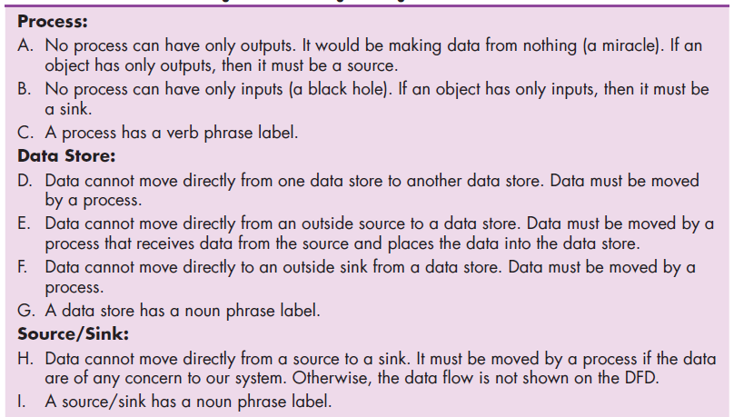
Data Flow Diagramming Rules (Cont.)
TABLE 7-2 Rules Governing Data Flow Diagramming

Slide 17
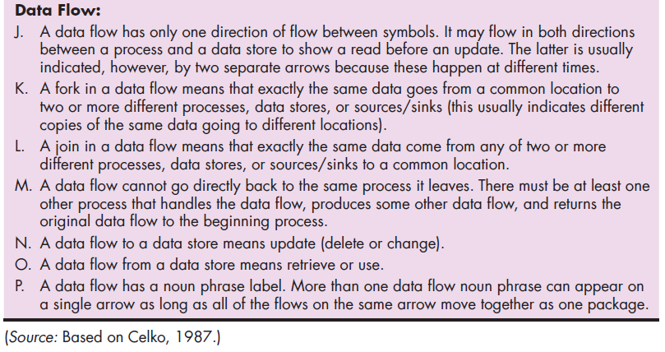
Data Flow Diagramming Rules (Cont.)
TABLE 7-2 Rules Governing Data Flow Diagramming (cont.)

Slide 18
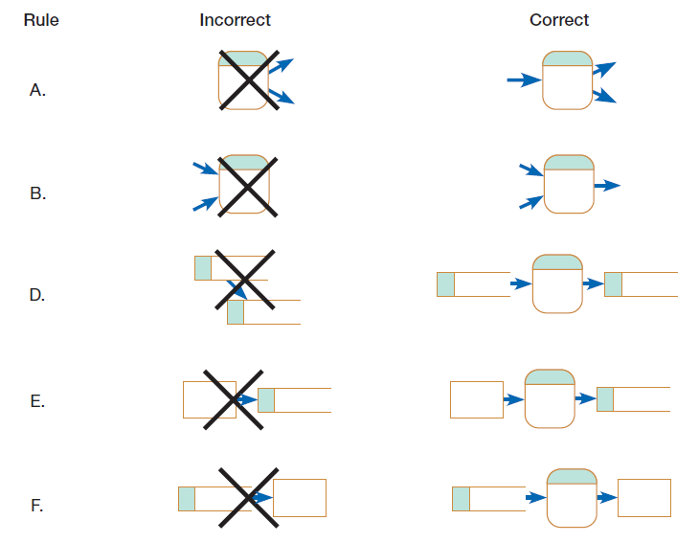
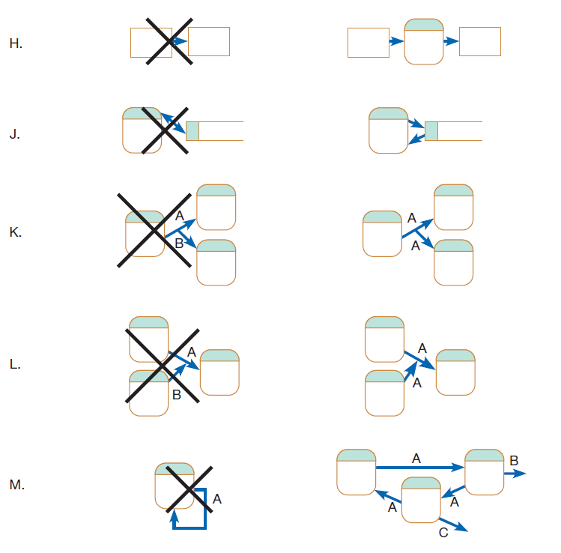
Data Flow Diagramming Rules (Cont.)
Figure 7-6
Incorrect and correct ways to draw DFDs

